Slide 1
User Guide

Slide 2

Sprint Updates
Client Meetings
How have client meetings gone?
Any requirement changes?
Lab Advisors
Regular Lab advisor meeting?
Sprint Progress
Only a two sprints left!
Any blockers?

Slide 3

User Manuals
Helps the user understand how to use the software
GUI navigation
Login
Business operations
Inventory control
Appointments
Online ordering

Slide 4

User Manuals
Reduces support costs
Product owner does not need to pay for customer support
Cheaper support leads to more user adoption
Frees up the software support team

Slide 5
User Manuals
Increases user adoption
Easier to learn the interface
Users can learn features that are less intuitive
Helps with training
Helps product owner train employees
Reduces training costs

Slide 6
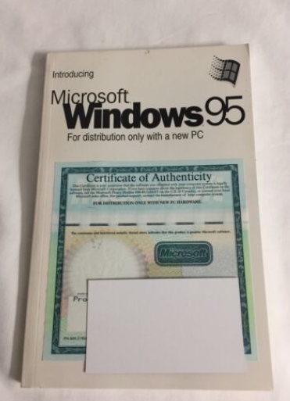
Hard Copy User Manuals
Today mostly used for embedded software
Mini mills
Vehicles (Car, Truck, ect..)
Used to come packaged with the software

Slide 7

Soft Copy User Manuals
Convenience of use
Easy to make copies and distribute
Easy to search (ctrl + f)
Able to view on a mobile device
Phone
Laptop
PC
We will make a PDF user manual this course

Slide 8

Knowledge Bases
Websites dedicated to help
A website for a website
Dev team for knowledge base
Costly solution
Robust search features
Can search a robust database not just a single PDF

Slide 9
Knowledge Bases
FAQ section
Questions that are already answered
Community Support
Ask a question and receive answers from other users “the community” or support staff

Slide 10

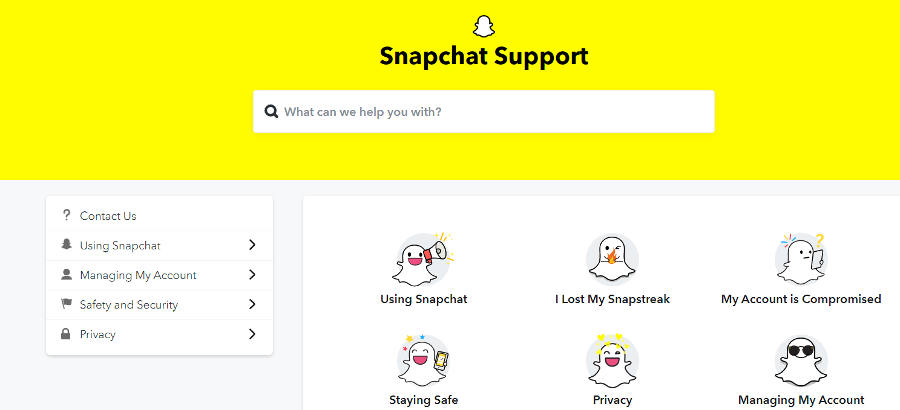
Snap Chat Example
Easy click options
My account is compromised
Search Bar
Options menu
Source: https://help.snapchat.com/hc/en-us

Slide 11
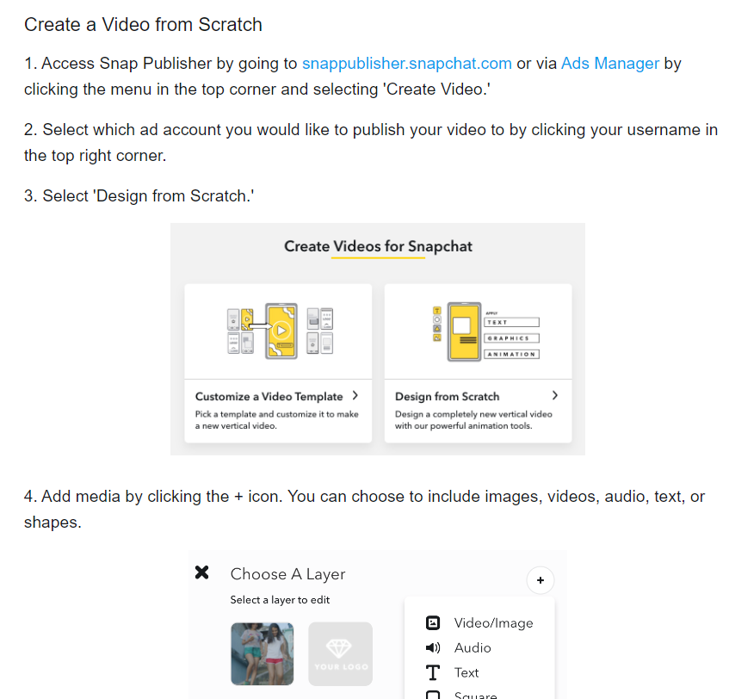
Snap Chat Example
Source: https://help.snapchat.com/hc/en-us

Slide 12


TikTok Example
Source: https://www.tiktok.com/safety/en/new-user-guide/

Slide 13

Are Videos Next?
Unofficial video tutorials
Natural community support
Not always accurate
Wrong software version
Official tutorials
Companies are realizing the power of incorporating video into their user mannuals

Slide 14

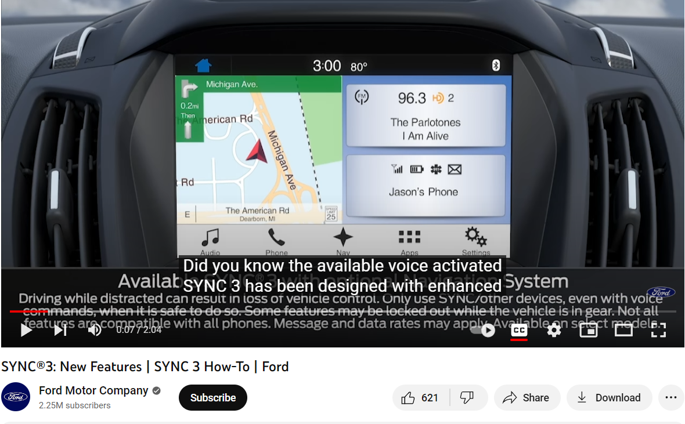
TikTok Example
Source: https://www.youtube.com/watch?v=d-Jju70Tqqg/

Slide 15

User Manual Assignment
Must show all the main features
All the user stories
Features that are important to the client
Everyone must contribute
All team members must contribute to a portion of the User Manual and sign the document

